Slide 1


Data Warehousing Laboratory Project following the CRISP-DM through the example of soccer statistics
Students: Onur Yavuz, Eugenio Donaque, Artur Baliet, Hannes Daniel

Slide 2
Structure
Introduction
CRISP-DM
Concept of the problem
Data Preparation
Solution approach
Implementation steps
Conclusion
References

Slide 3
Introduction
Football is the most popular sport on this planet and games from previous seasons
are compared to follow the development
Our task was to enable useful information out of the huge amount of data
We solved this task through following the CRISP-DM process.

Slide 4

CRISP-DM
Figure 1: Crisp-DM model
https://statistik-dresden.de/archives/1128

Slide 5
Business Understanding Phase
Our topic: Soccer statistics about the Bundesliga in Germany
Our goal: Understand the Performance development of a team

Slide 6
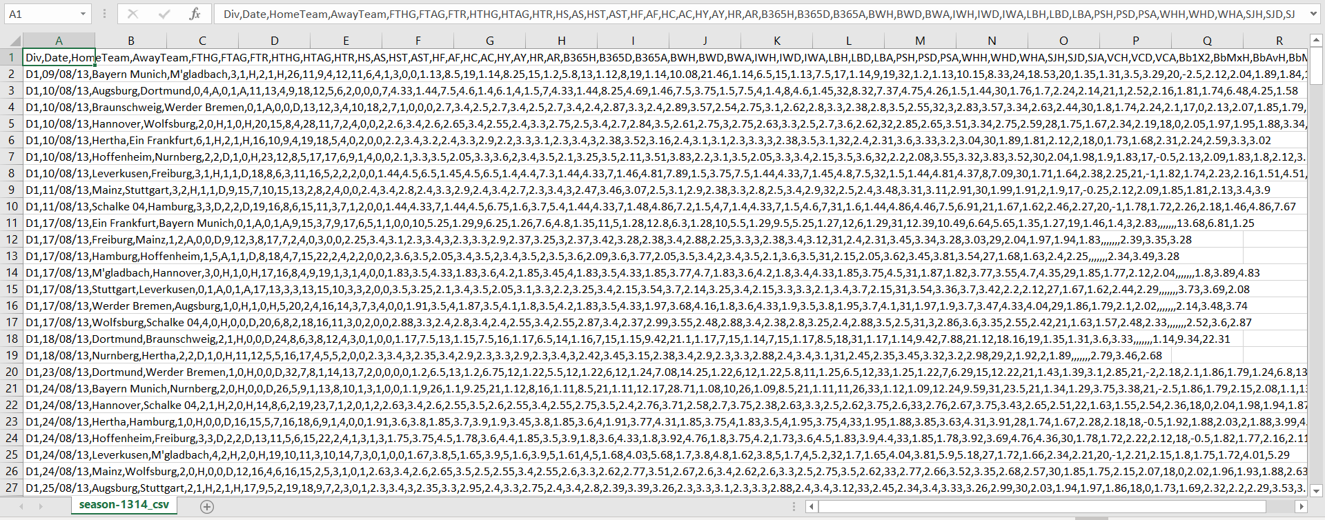
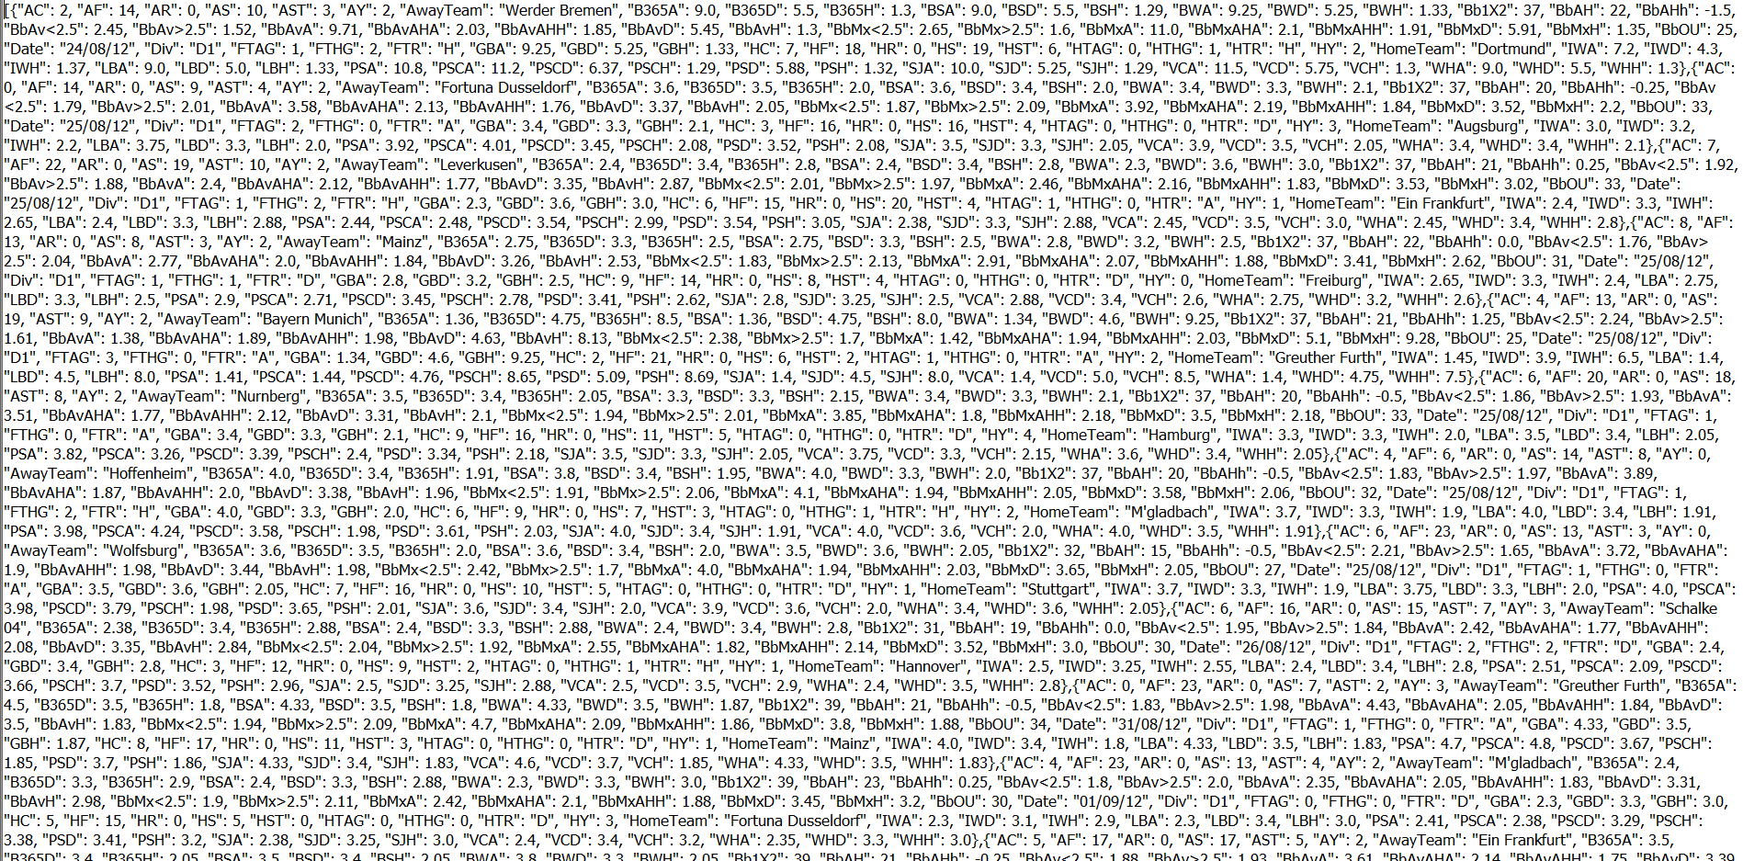
Data Understanding Phase
Source
Open Data: http://www.football-data.co.uk/
Contains data for last 10 seasons of German Bundesliga including current season
Contains various statistical data
Each season in a separate file
← row data →

Slide 7
Necessary tools:
Latex → perform analytic report
Microsoft Excel → convert to CSV-files
PhpMyAdmin → build new database
MySQL Workbench → design and build DWH/ DM

Slide 8
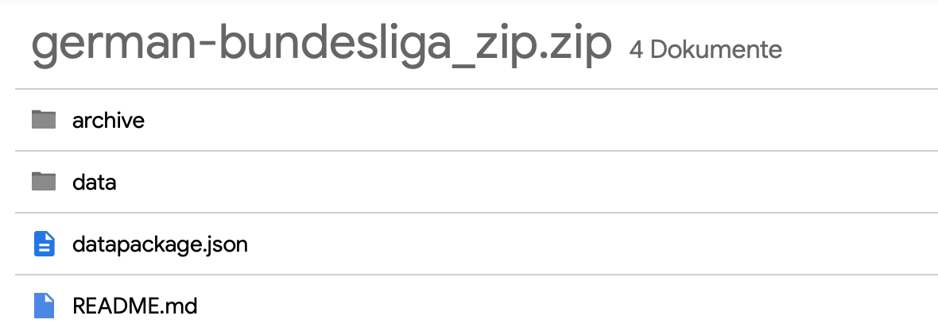
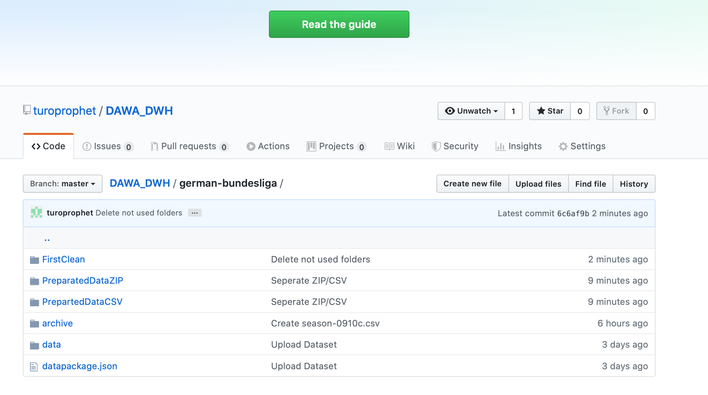
GitHub
Source code management
Repository
Work efficently in our team

Slide 9
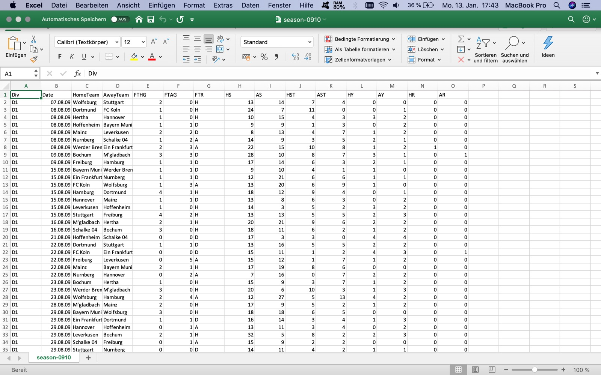
Data Preparation Phase
Data Preparation
Cleansing
Compress CSV in ZIP
Upload all Seasons (csv.zip)

Slide 10
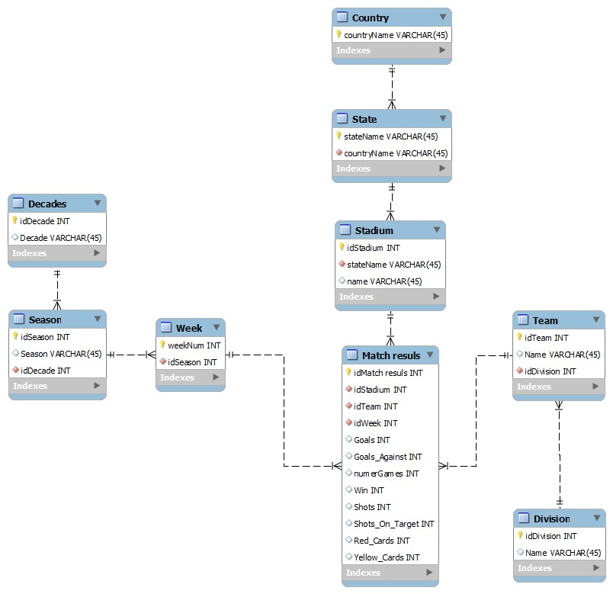
Star Schema
Figure 2: Star Schema

Slide 11
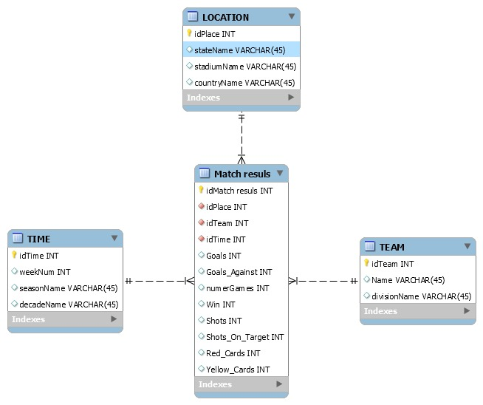
Data Mart
Figure 3: Data Mart

Slide 12


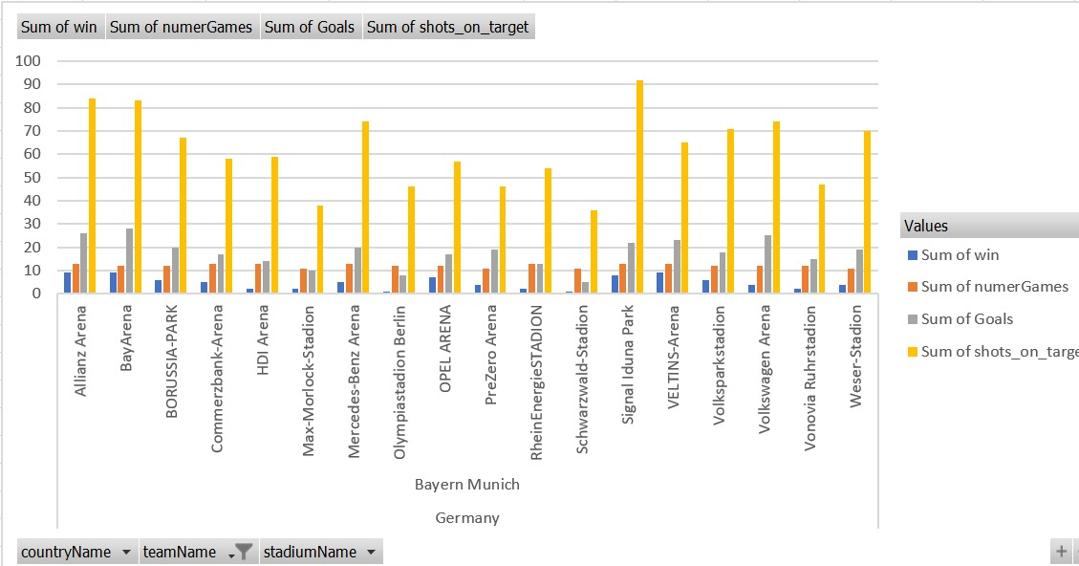

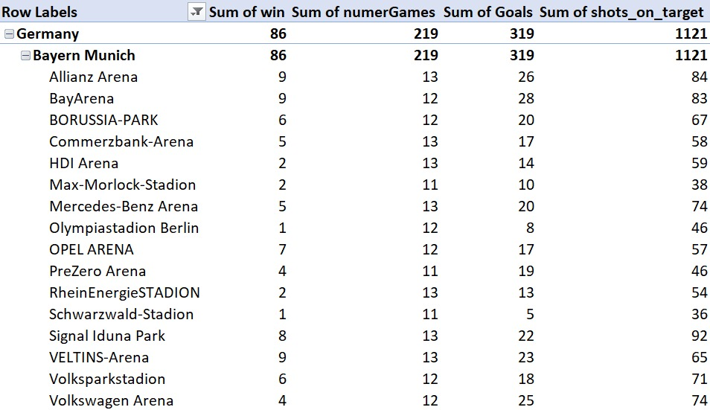
Bayern Munich
Performance of BM depending on the stadium

Slide 13
Conclusion
Raw data is used to create a Data Warehouse
Check the data quality and reduced to the relevance data
Easy and compact information about the football statics
Good a new experience for the group

Slide 14
Thank you...

